Slide 1
Hostel Accommodation & Student Services
Presentation-III: Final Demonstration
Name: Vallamkondu Sai Jaideep Roll no.: 25WU0101149
Course: Database Management Systems (DBMS)
Faculty: Kiran Mayee Adavala
Year: 2026-27

Slide 2
Problem and Objectives
Paper registers cause duplicate records, lost fee data and slow complaint handling
Objective: one normalised MySQL database for staff, blocks, rooms, students, fees, complaints, mess and visitors
Web admin panel to insert, view and delete records in all 8 modules
SQL reports: room occupancy, unpaid fees, open complaints, mess revenue

Slide 3
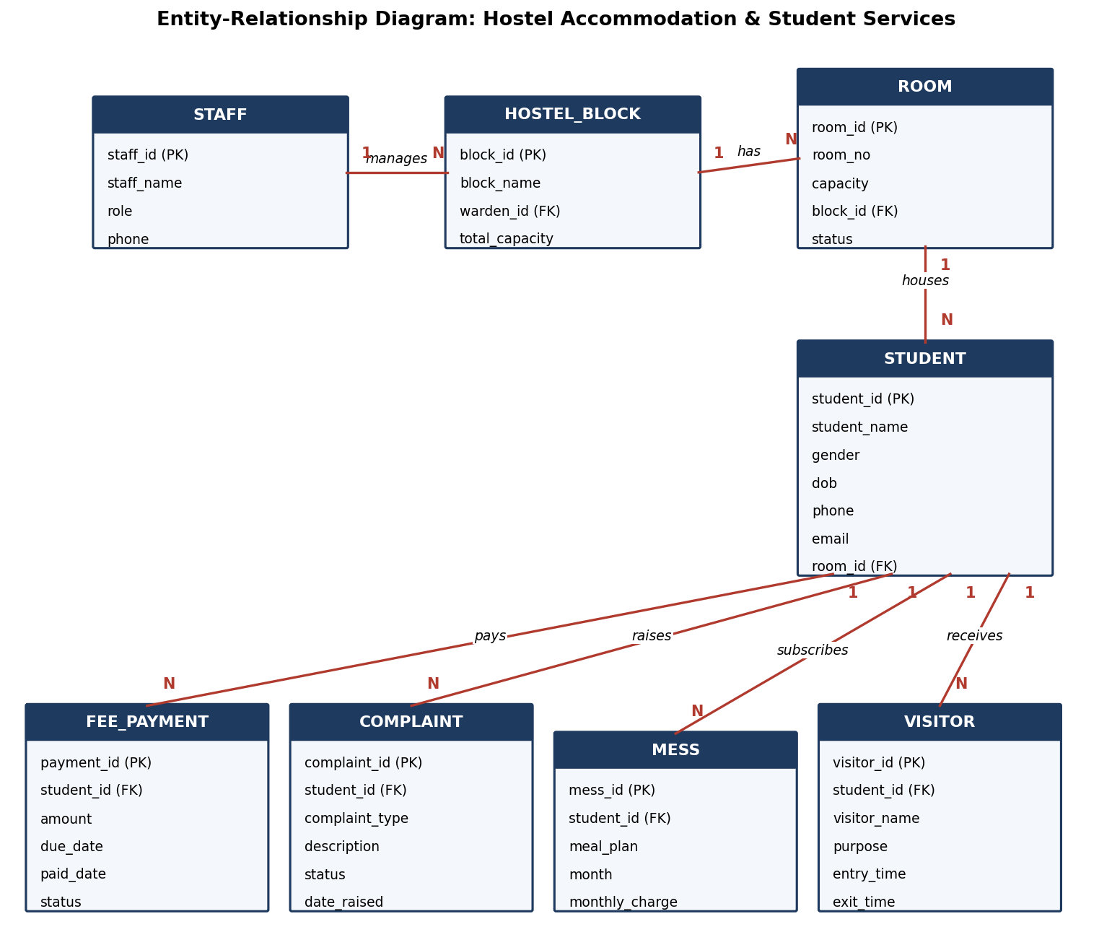
ER Diagram: 8 Related Tables
Staff 1:N Hostel_Block (warden)
Hostel_Block 1:N Room
Room 1:N Student
Student 1:N Fee_Payment, Complaint, Mess, Visitor
Schema is in 3NF; foreign keys keep data consistent

Slide 4
Technology and Implementation
Node.js v24.15.0, started with npm start (port 3000)
MySQL database; connection pool in config/db.js
HTML, CSS, JavaScript panel with sidebar for 8 modules
Parameterised queries (?) prevent SQL injection
Drop-downs filled from related tables enforce valid foreign keys

Slide 5
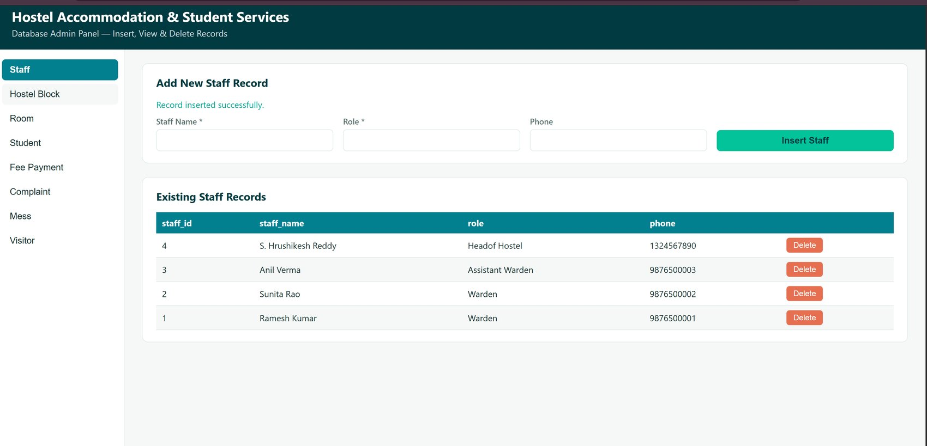
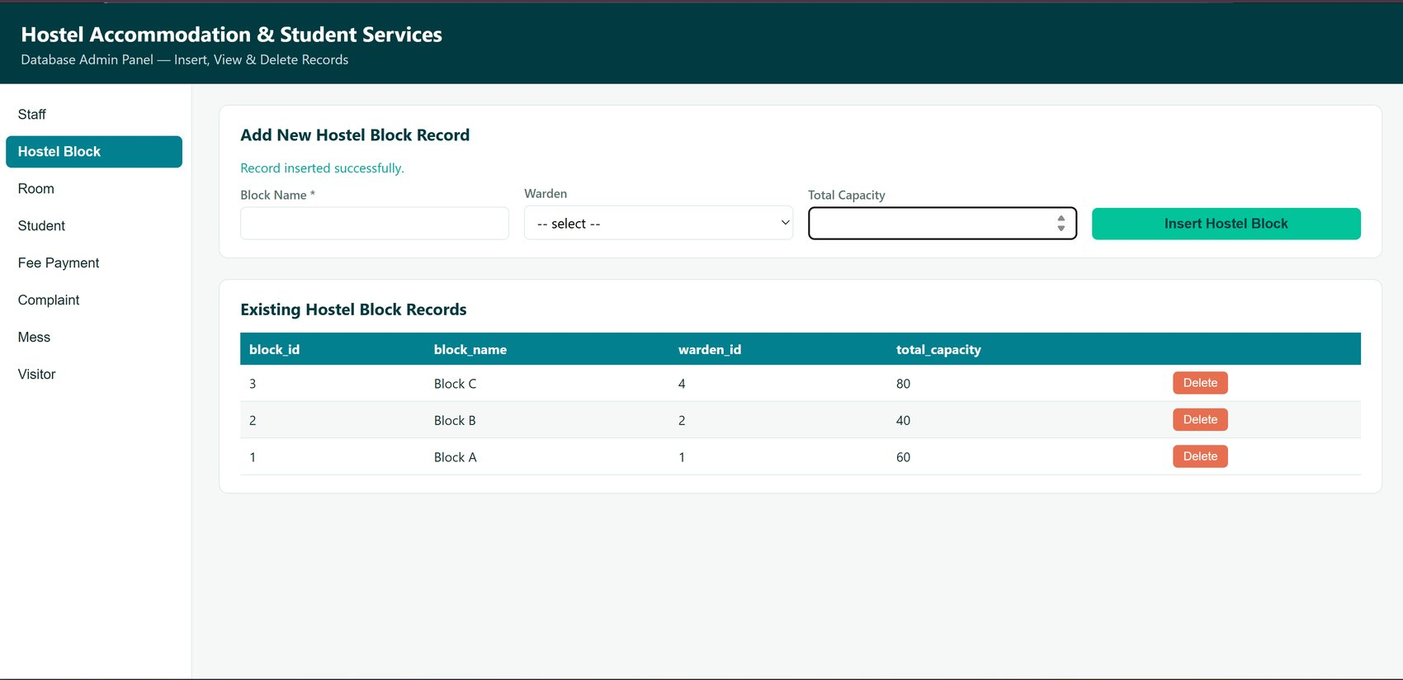
UI Screens: Staff and Hostel Block
Staff: view + insert success message
Hostel Block: view + warden drop-down

Slide 6
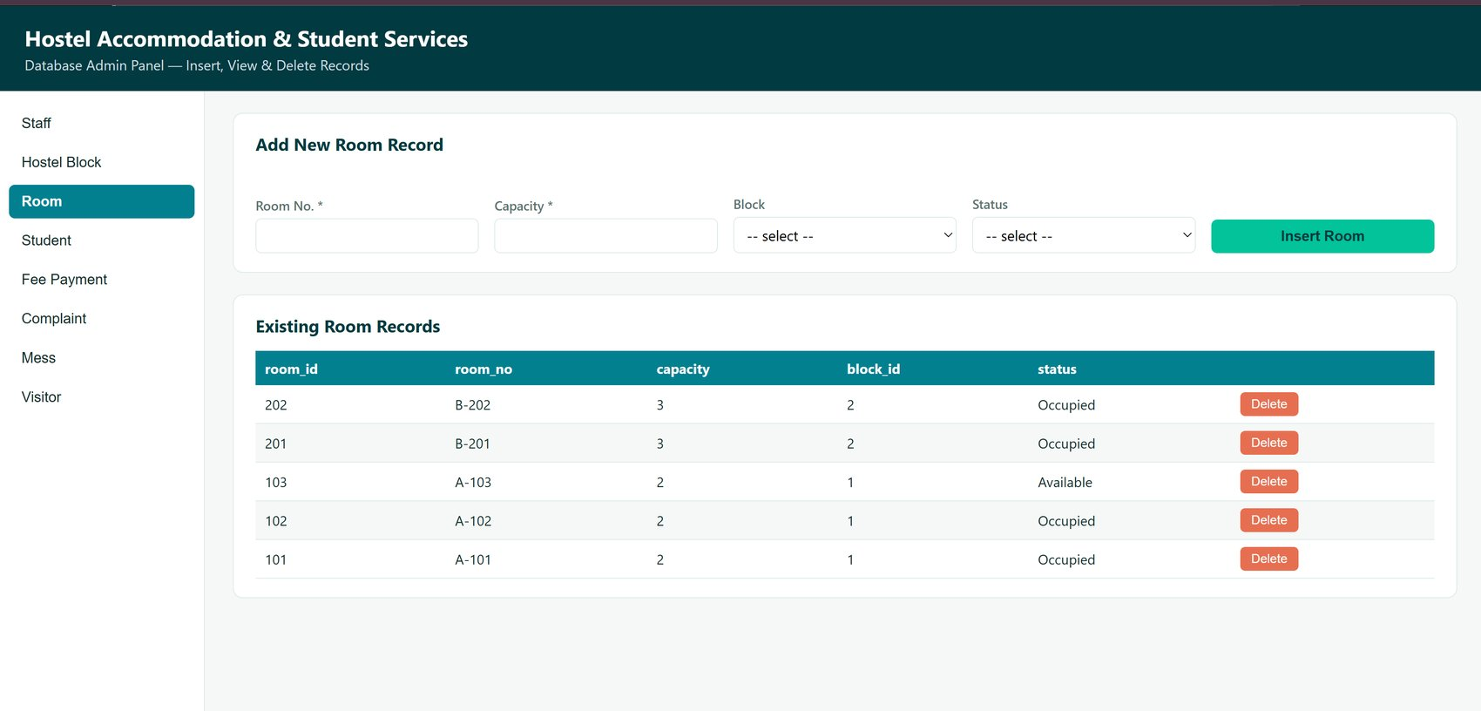
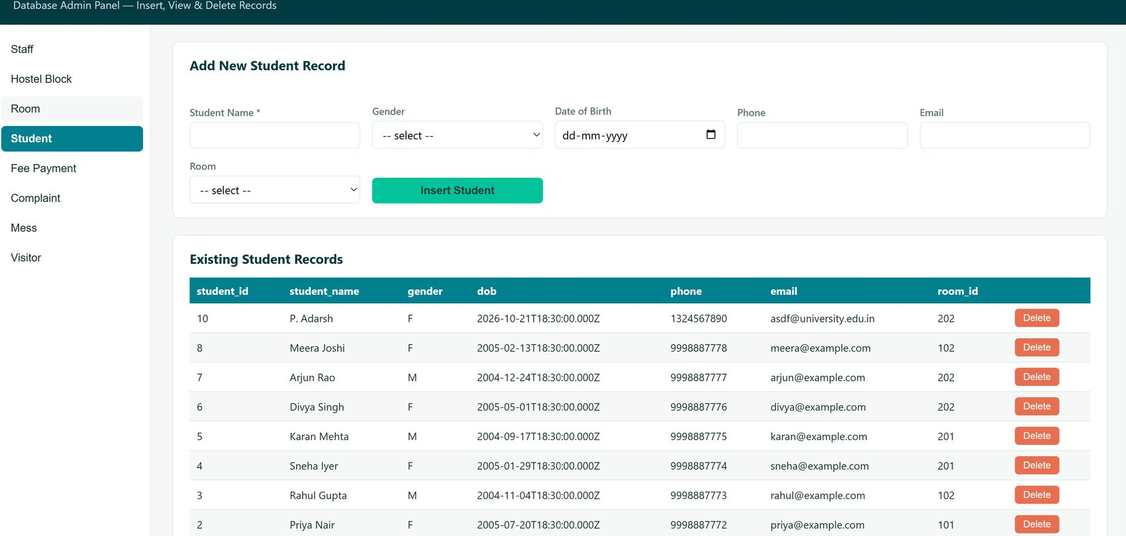
UI Screens: Room and Student
Room: view + block and status drop-downs
Student: view + room drop-down

Slide 7
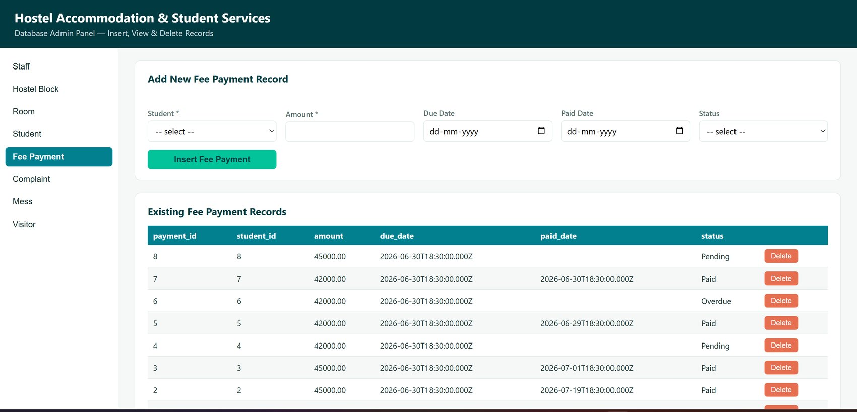
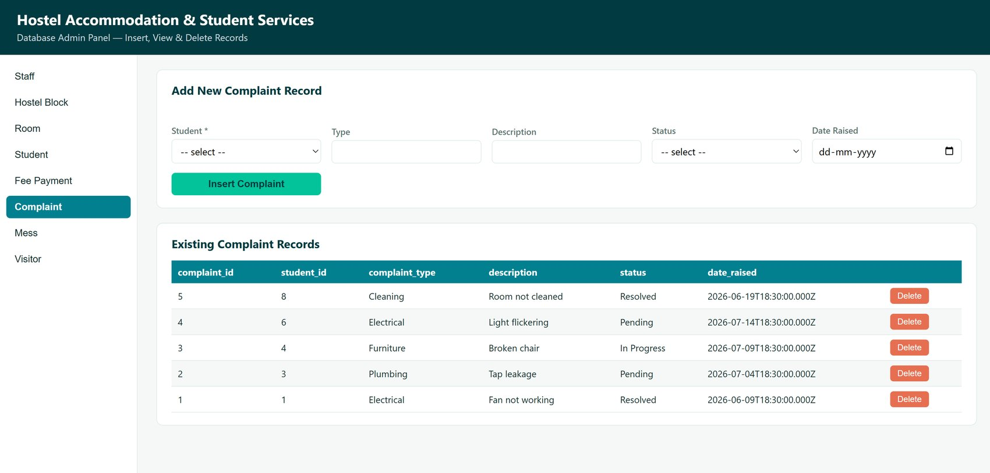
UI Screens: Fee Payment and Complaint
Fee Payment: view with status
Complaint: view with status

Slide 8
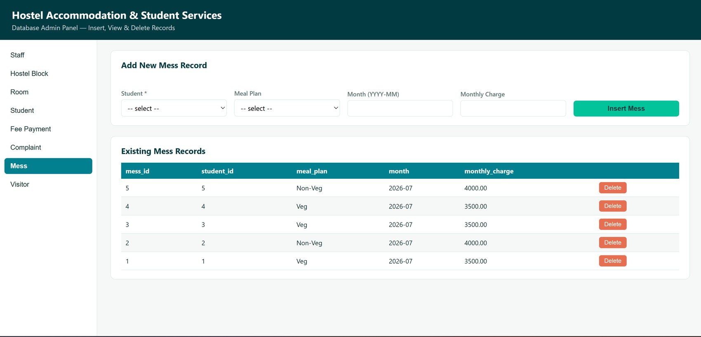
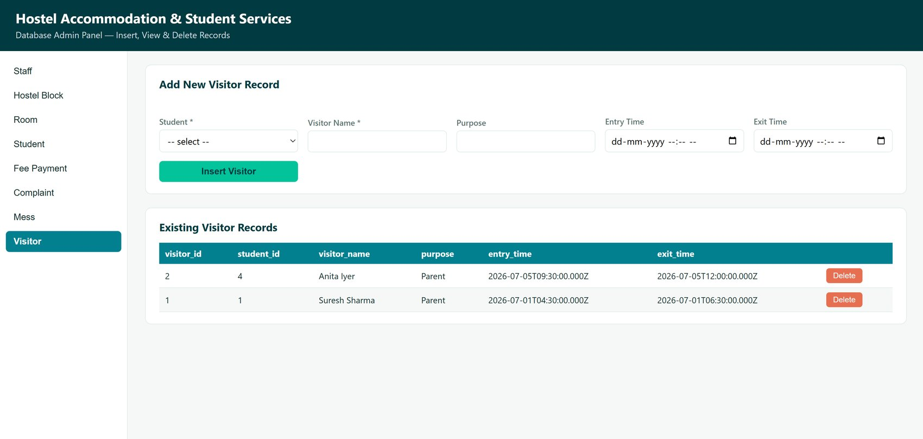
UI Screens: Mess and Visitor
Mess: view with meal plan
Visitor: view with entry/exit time

Slide 9
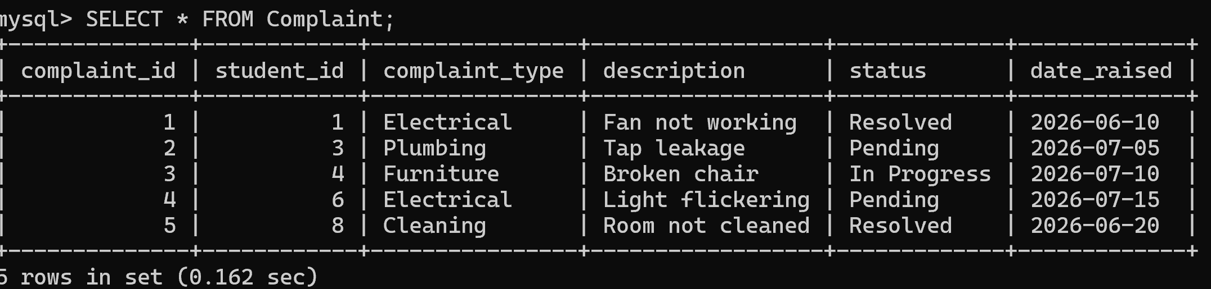
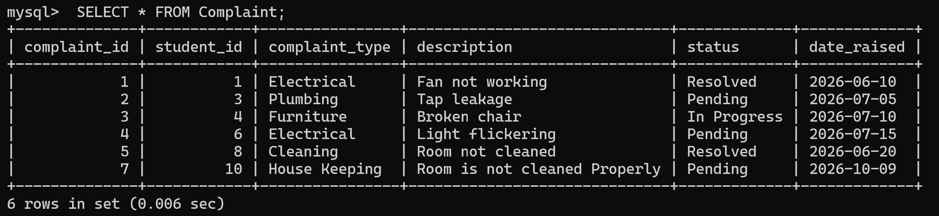
Insert Operation: Before and After
[Insert screenshot: form filled, BEFORE clicking Insert]
[Insert screenshot: AFTER insert, new row in table]
Each row has a Insert button; the row appears in the table and in MySQL.

Slide 10
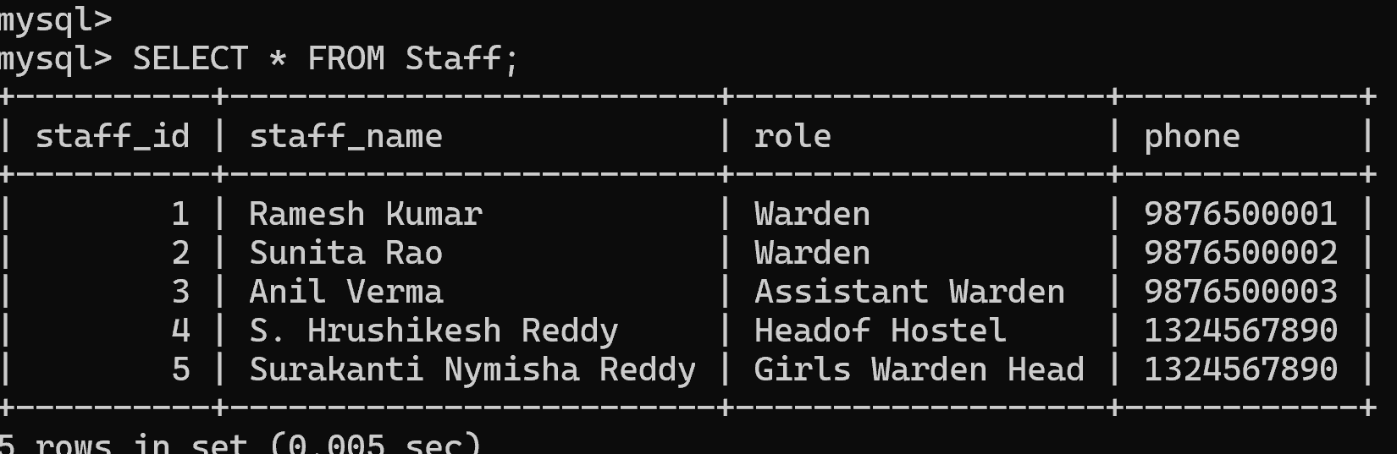
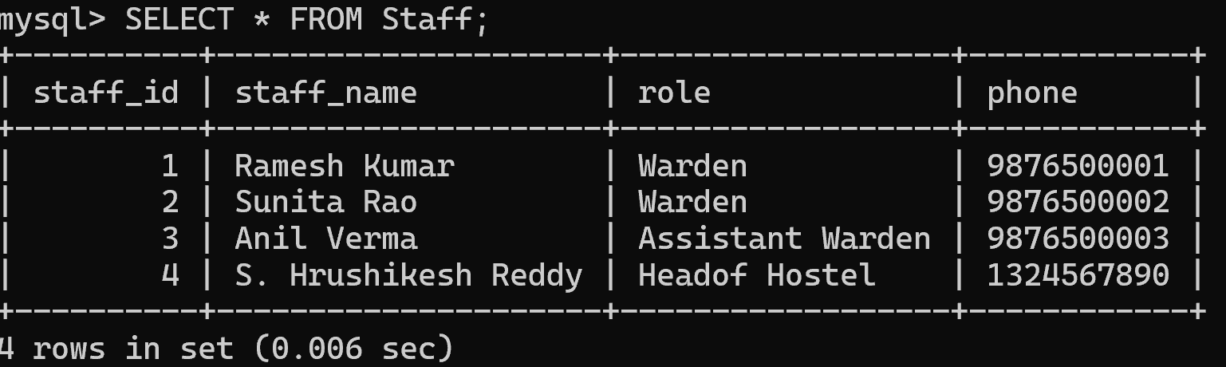
Delete Operation: Before and After
Before: Staff table with 5 rows
After: row 5 deleted, 4 rows remain
Each row has a Delete button; the row disappears from the table and from MySQL.

Slide 11
Sample SQL Query Results
Unpaid fees (JOIN)
Fees by status (GROUP BY)
student_name | amount | status
Divya Singh | 42000.00 | Overdue
Meera Joshi | 45000.00 | Pending
Sneha Iyer | 42000.00 | Pending
status | payments | total_amount
Overdue | 1 | 42000.00
Paid | 5 | 219000.00
Pending | 2 | 87000.00

Slide 12
Conclusion and Future Work
Normalised 8-table design with working insert, view and delete in every module
Future: edit option, form validation, DD-MM-YYYY dates, login roles, fee reminders, dashboard charts
Source code: https://github.com/jaideepvallamkondu-tech/DBMS-Course-Project

